Slide 1
Swedbank IT Academy 2022 OOP Basics Part I
Deividas Kybartas

Slide 2
Agenda
What is a package?
Java classes and objects
Enum
Methods
Access modifiers

Slide 3
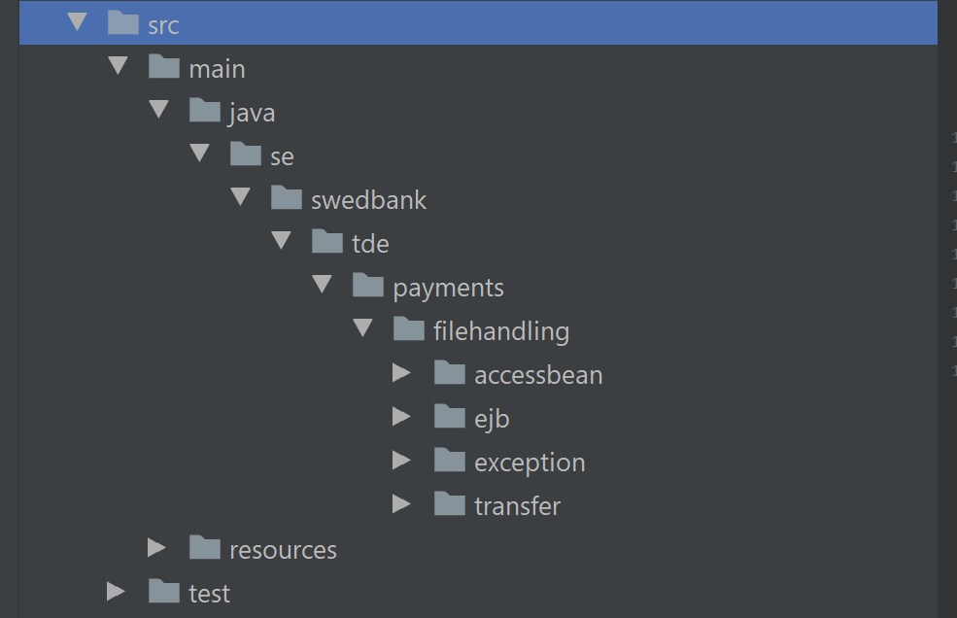
Package, Class, Object.. what’s that?
Package, what you need to know?
Naming
Categorization
Access protection
Name collision protection

Slide 4
Class Object
A Class is a blueprint, template, or prototype that defines the variables and the methods common to all objects of the same kind
Object acts as a member, specimen, or instance of the class

Slide 5


CLASS
BLUEPRINT
OBJECT

Slide 6
Class
CLASS
Player
BLUEPRINT
attributes
name
age
id
hairColour
methods
run()
eat() speak()
play()

Slide 7
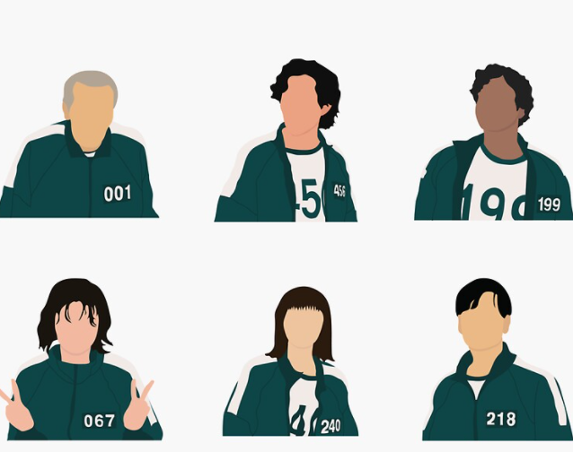
Object
name: Oh Il-nam id: 001 age: 105 hearColour: gray
name: Seong Gi-hun id: 455 age: 31 hearColour: dark
…

Slide 8
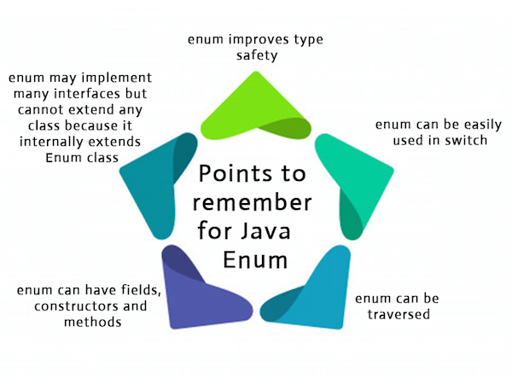
Enum

Slide 9
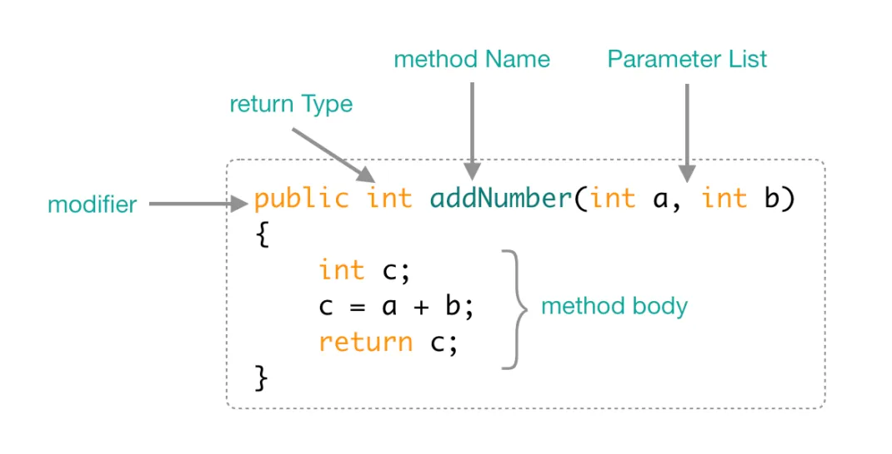
Methods
Methods, what you need to know?
Overloading
Static methods
Methods with/without parameters
Naming

Slide 10
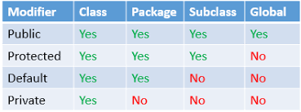
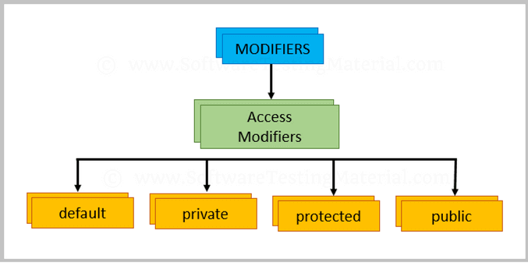
Access modifiers

Slide 11
Tasks

